Slide 1

INTERNET OF THINGS
Chapter3: Smart Objects: The “Things” in IoT
Dr. Nagegowda K S
Department of Computer Science & Engineering

Slide 2
INTERNET OF THINGS
Agenda
Sensors
Actuators
Smart Objects
Sensor Networks

Slide 3
INTERNET OF THINGS
Sensors
Active or passive
Invasive or non-invasive
Contact or no-contact
Absolute or relative
Area of application
How sensors measure
What sensor measure

Slide 4
INTERNET OF THINGS
Sensors

Slide 5
INTERNET OF THINGS
Sensors

Slide 6
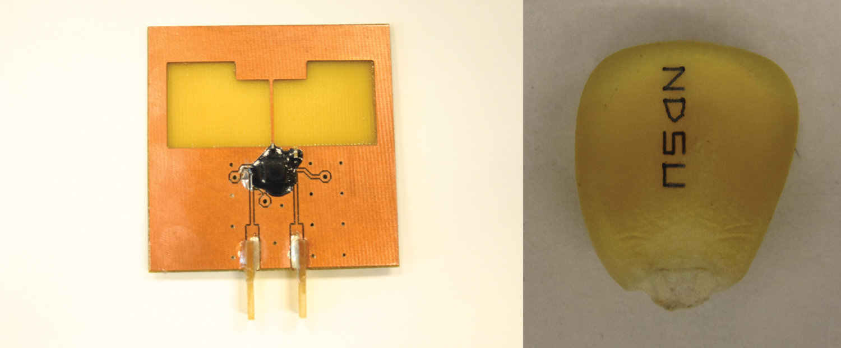
INTERNET OF THINGS
Sensors
Figure - Biodegradable Sensors Developed by NDSU for Smart Farming (Reprinted with permission from NDSU.)

Slide 7
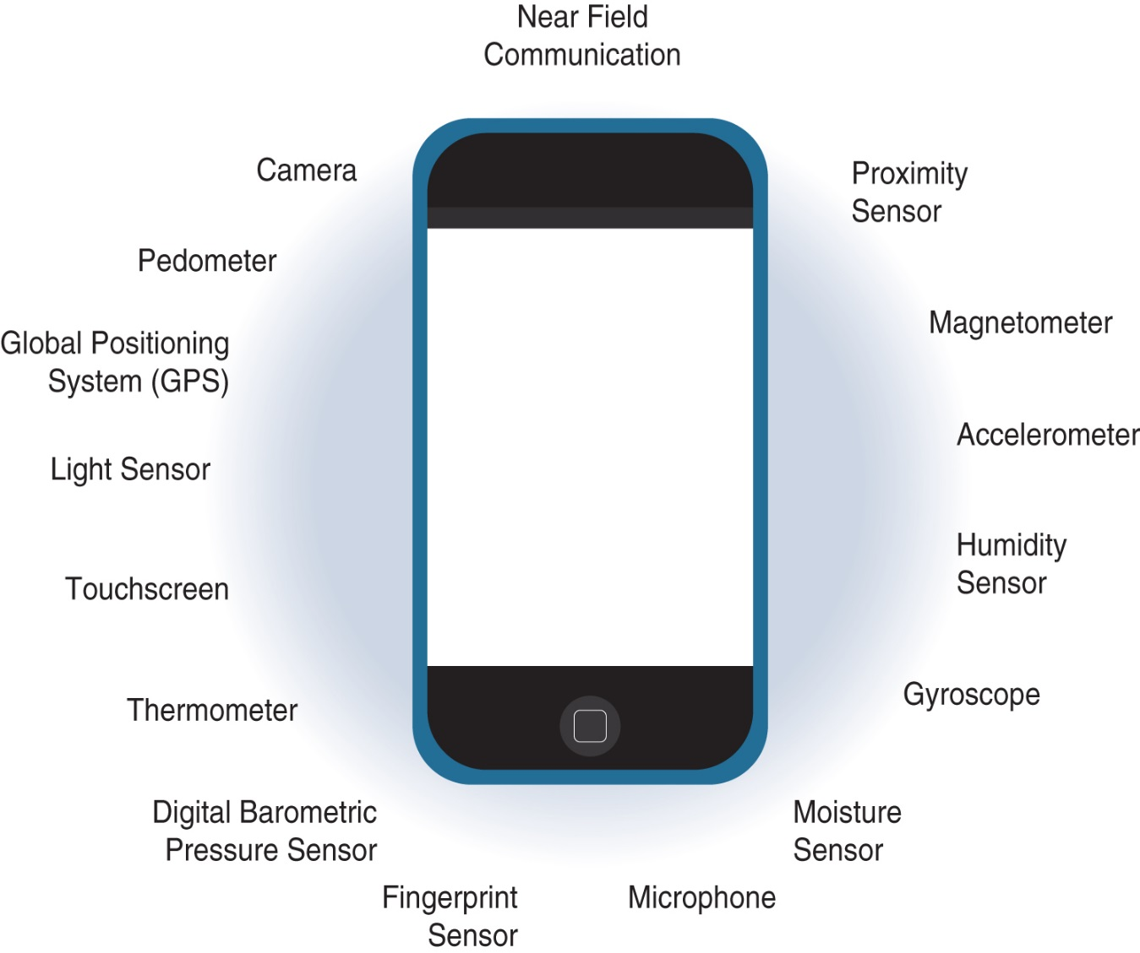
INTERNET OF THINGS
Sensors
Figure - Sensors in a Smart Phone

Slide 8
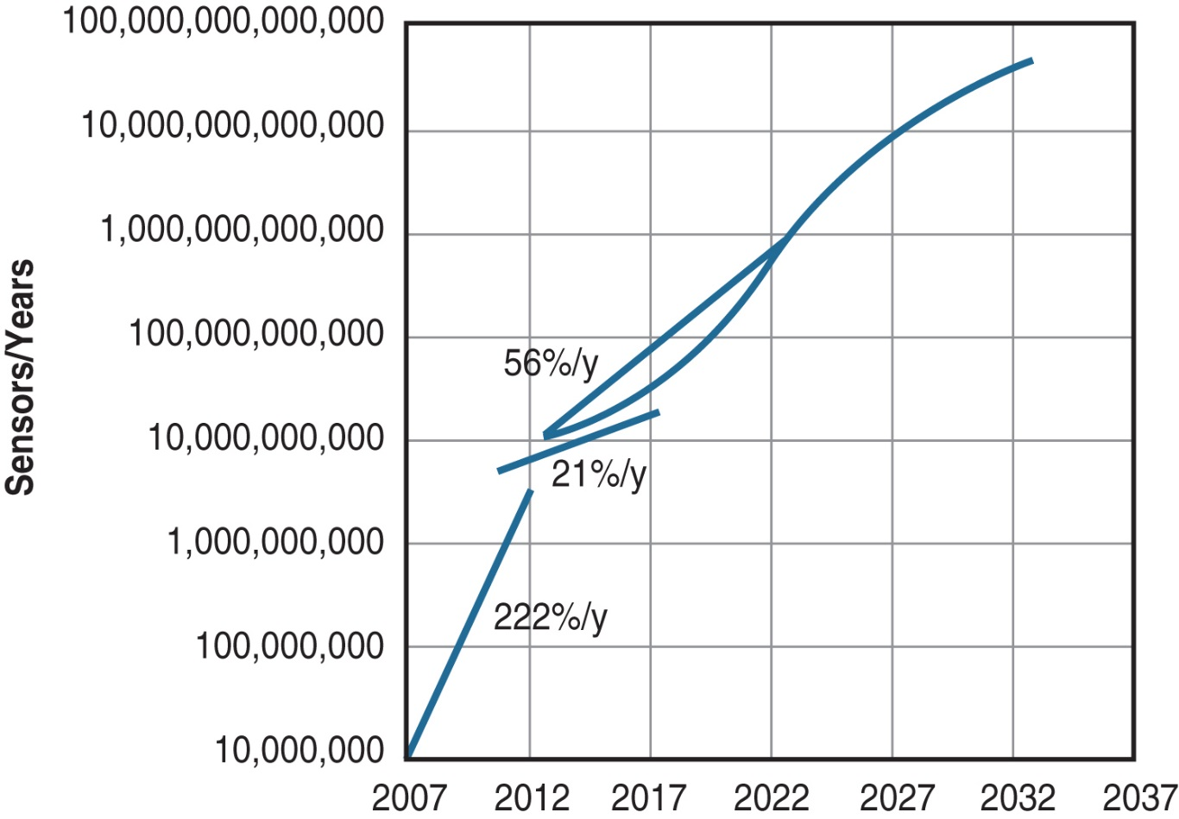
INTERNET OF THINGS
Sensors
Figure - Growth and Predictions in the Number of Sensors

Slide 9
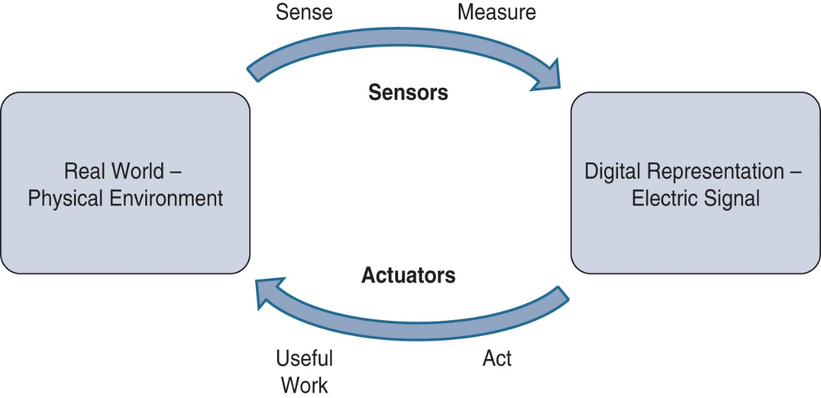
INTERNET OF THINGS
Acutators
Figure - How Sensors and Actuators Interact with the Physical World

Slide 10
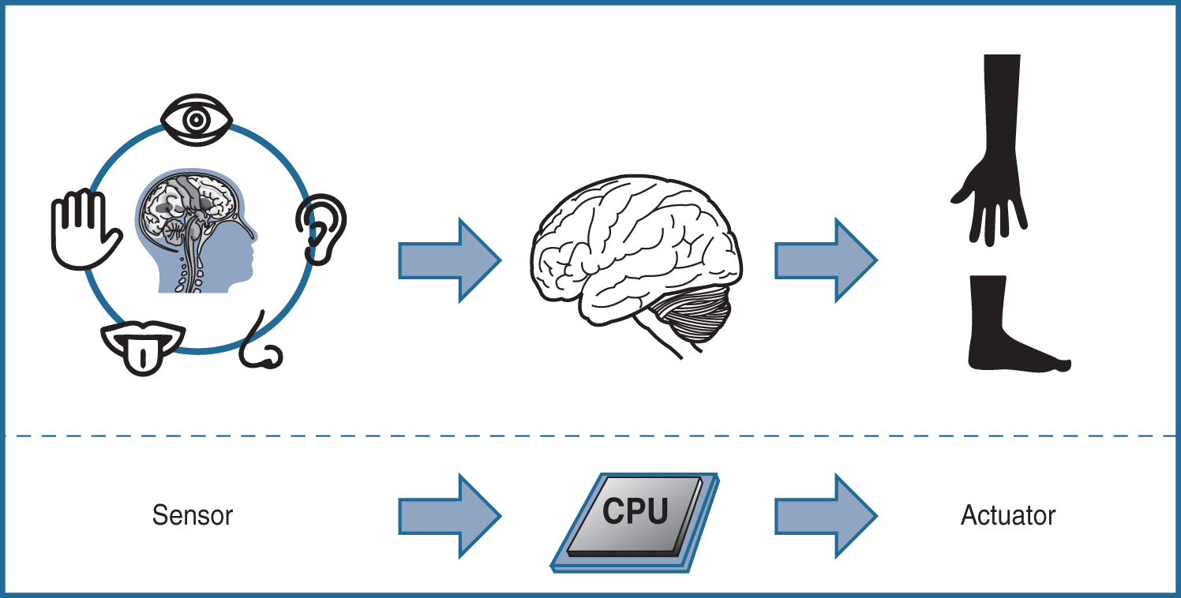
INTERNET OF THINGS
Acutators
Figure - Comparison of Sensor and Actuator Functionality with Humans

Slide 11
INTERNET OF THINGS
Acutators
Type of motion
Power
Binary or continuous
Area of application
Type of energy

Slide 12
INTERNET OF THINGS
Acutators

Slide 13
INTERNET OF THINGS
Smart Objects
Defining characteristics of Smart Object:
Processing unit
Sensors and actuators
Communication device
Power Source

Slide 14
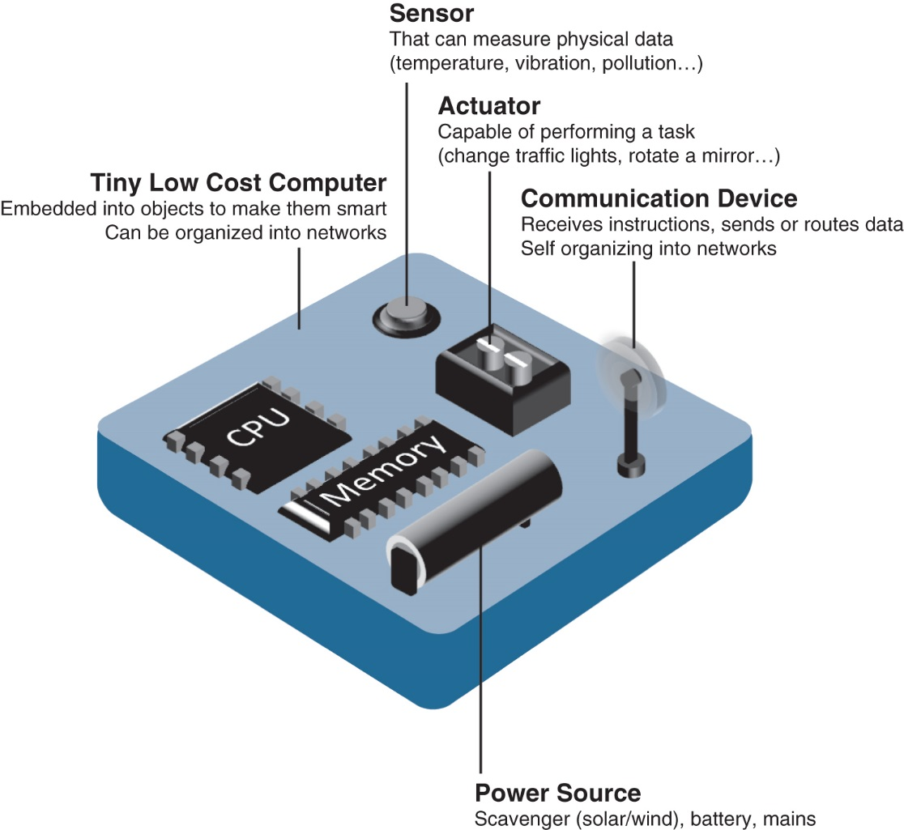
INTERNET OF THINGS
Smart Objects
Figure - Characteristics of a Smart Object

Slide 15
INTERNET OF THINGS
Smart Objects
Trends in Smart Objects:
Size is decreasing
Power consumption is decreasing
Processing power is increasing
Communication capabilities are improving
Communication is being increasingly standadized

Slide 16
INTERNET OF THINGS
Sensor Network
Advantages of SANET:
Greater deployment flexibility (especially in extreme environments or hard-to-reach places)
Simpler scaling to a large number of nodes
Lower implementation costs
Easier long-term maintenance
Effortless introduction of new sensor/actuator nodes
Better equipped to handle dynamic/rapid topology changes

Slide 17
INTERNET OF THINGS
Sensor Network
Disadvantages of SANET:
Potentially less secure (for example, hijacked access points)
Typically lower transmission speeds
Greater level of impact/influence by environment

Slide 18
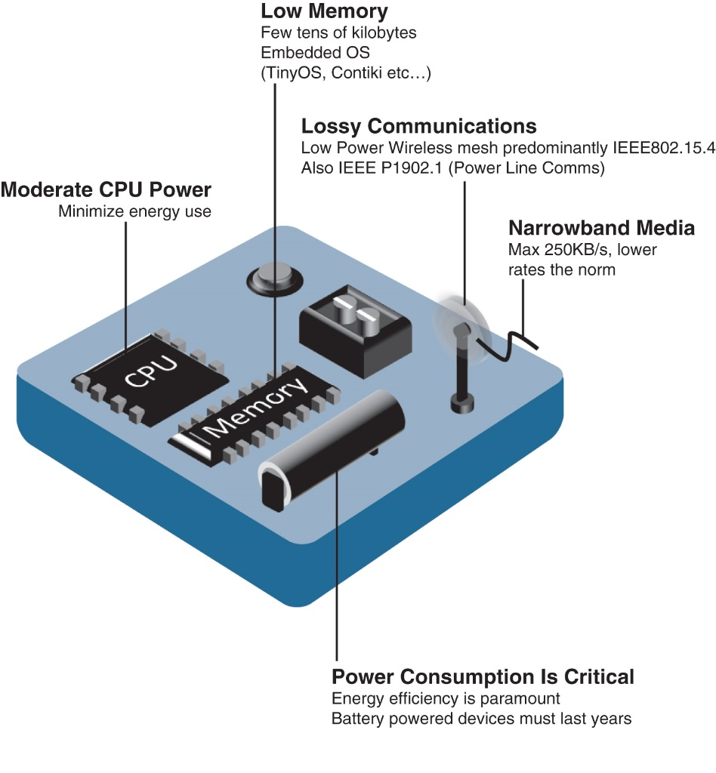
INTERNET OF THINGS
Wireless Sensor Network
The following are some of the most significant limitations of the smart objects in WSNs:
Limited processing power
Limited memory
Lossy communication
Limited transmission speeds
Limited power
Figure - Design Constraints for Wireless Smart Objects

Slide 19
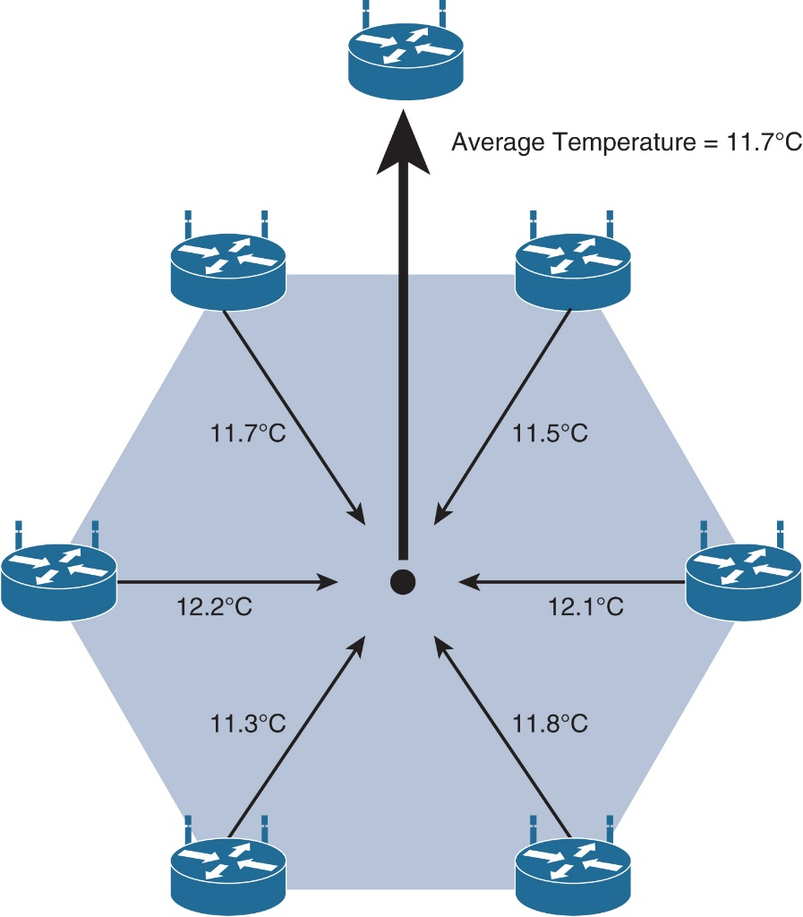
INTERNET OF THINGS
Wireless Sensor Network
Two Communication Pattern:
Event-driven
Periodic
Figure - Data Aggregation in Wireless Sensor Networks

Slide 20

THANK YOU
Dr. Nagegowda K S
Department of Computer Science & Engineering
nagegowda@pes.edu

